Slide 1
Stems List 4!
Stems tests are on Tuesdays.

Slide 2
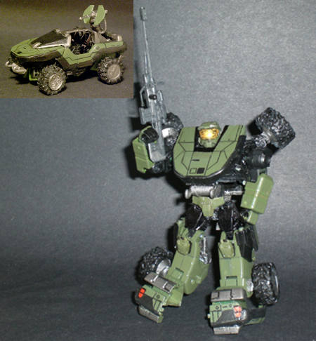
morph-
metamorphosis
amorphous
Mesomorph
Morphine
Morpheus- Teon
shape !!!!!!!

Slide 3
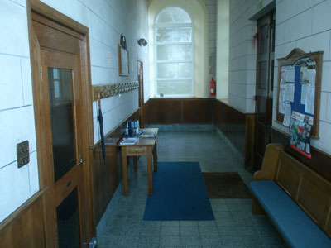
vest-
vestibule
vest
vestment
Divestiture
Vestidos- Spanish for clothes or dress
clothes !!!!!!!

Slide 4
bene-
benefit
Beneful, Benefiber
beneficial
benediction
benign (a non-cancerous tumor)
benevolent
good !!!!!!!

Slide 5
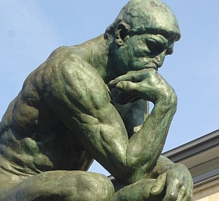
pond-
pound
ponder
ponderous
compound
preponderance
heavy !!!!!!!

Slide 6
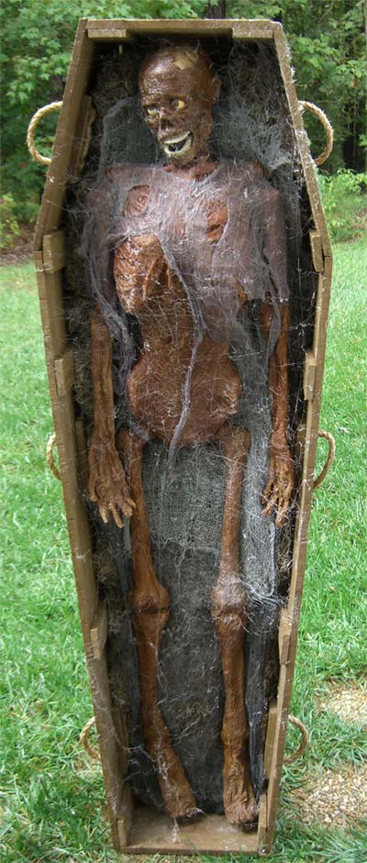
corp-
Marine Corp
corpse
corpulent
Corporal
Americorp
corporation
body !!!!!!!

Slide 7
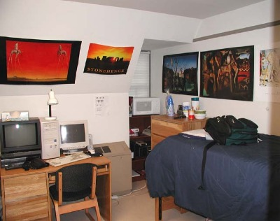
dorm-
dormant
dormitory
dorm (short for the above word)
dormir- (the Spanish word for sleep)
dormitorio (Spanish for a dormitory)
sleep !!!!!!!

Slide 8
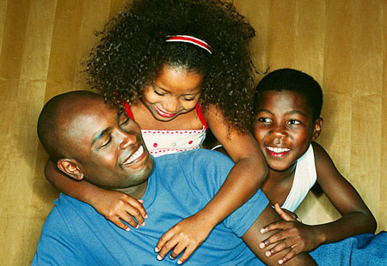
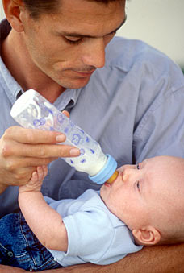
pater-
paternalistic
patriarch (male head of a family)
paternity
ex-patriate
father !!!!!!!

Slide 9
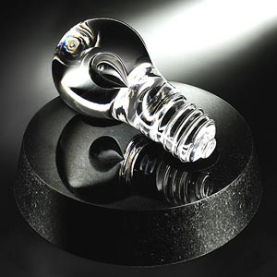
nov-
novelty shop
novel (the adjective)
novice
Nova Scotia
renovate (to make like new)
innovation (a new invention)
new !!!!!!!

Slide 10
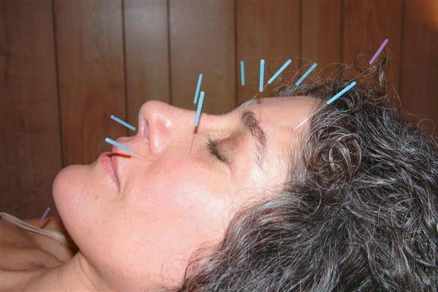
punct-
punctual
punctuation
puncture
acupuncture
point !!!!!!!

Slide 11
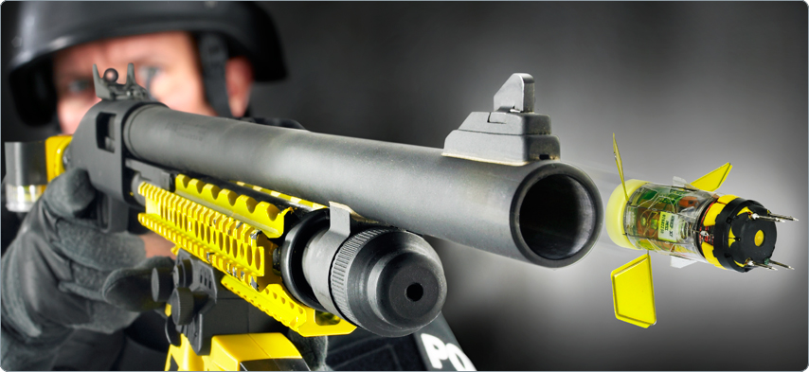
ject-
conjecture (to throw out an idea)
projectile (something thrown)
interjection (a word that is thrown at the beginning of a sentence, or a comment thrown into a conversation)
Interject (to interrupt by throwing a comment into a conversation)
Eject (object ??)
throw !!!!!

Slide 12
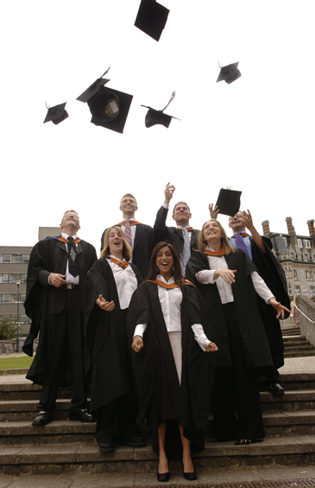
-tion
graduation
activation
promotion
creation
production
act or state !!!!!!!

Slide 13
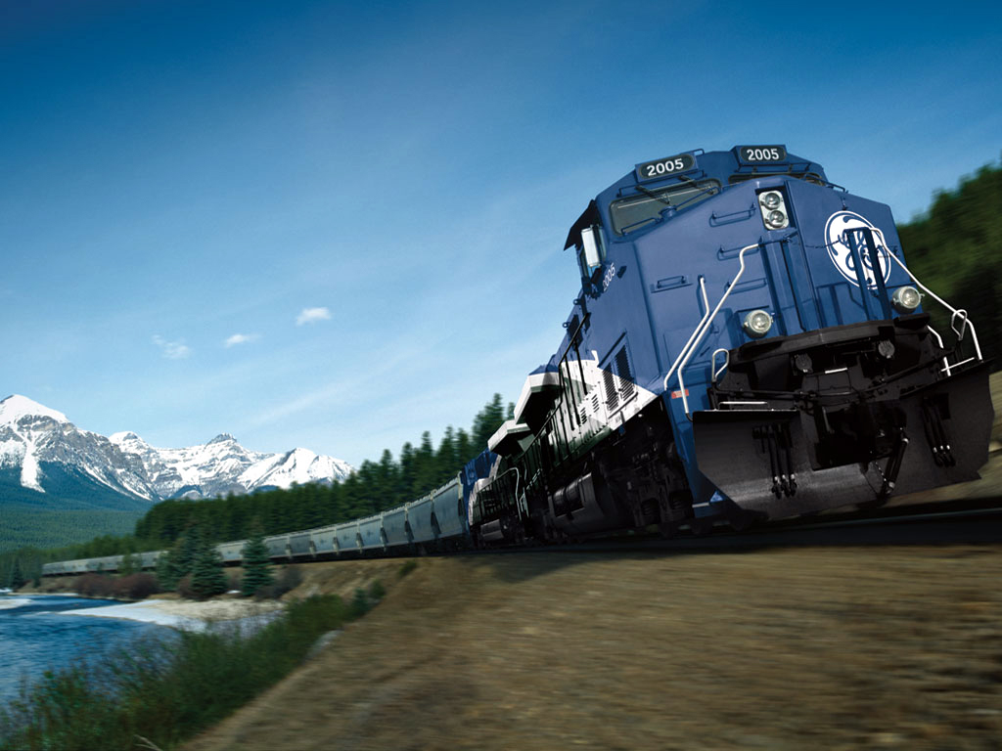
loco-
locomotion
locomotive
local
relocate
dislocate
place !!!!!!!

Slide 14
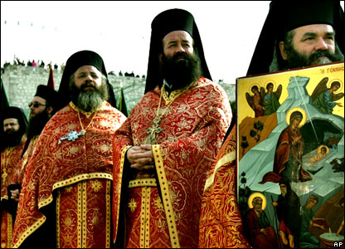
-dox-
doxology
orthodox (traditional)
unorthodox (non-traditional)
paradox
indoctrinate
opinion !!!!!!!
Priests in the Greek Orthodox church

Slide 15
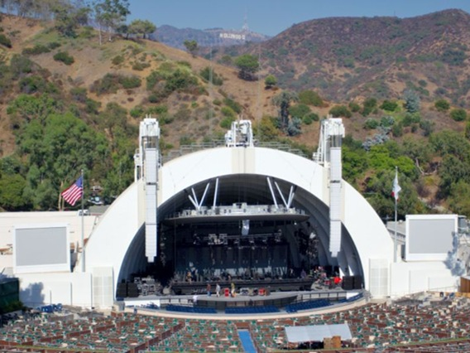
amphi-
amphibious
amphibian
amphitheater
both !!!!!!!

Slide 16
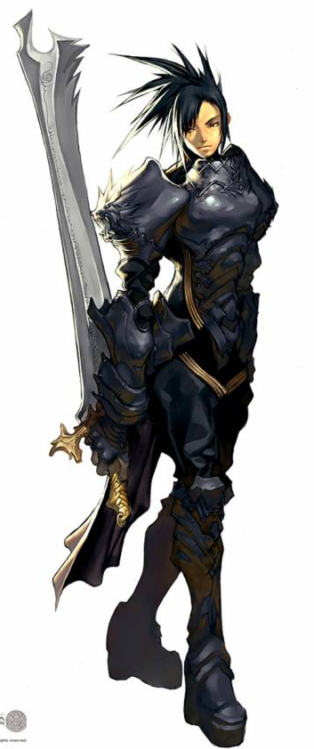
magn-
The Magna Carta (a famous historical document)
magnificent
magnanimous
magnate (a person of rank or power)
great !!!!!!!
Anime: Magna Carta

Slide 17
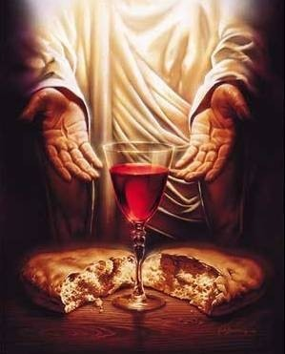
eu-
Eucharist
eulogy
euphemism
euphony (a good sound)
euthanasia
good !!!!!!!
Brandon picked this.

Slide 18
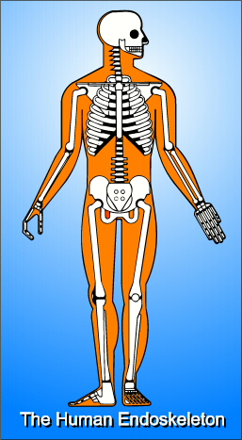
endo-
endoskeleton
endocrine
endothermic (warm-blooded, as opposed to cold-blooded)
within !!!!!!!
(intra- also meant within)

Slide 19
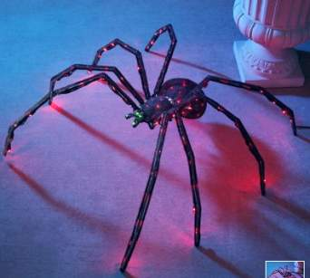
phobia-
arachnophobia (fear of spiders)
hydrophobia
xenophobia (fear of foreigners)
fear !!!!!!!

Slide 20
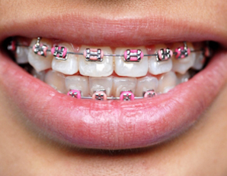
ortho-
orthodontist
orthopedist
orthodontics
orthodox
straight !!!!!!!

Slide 21
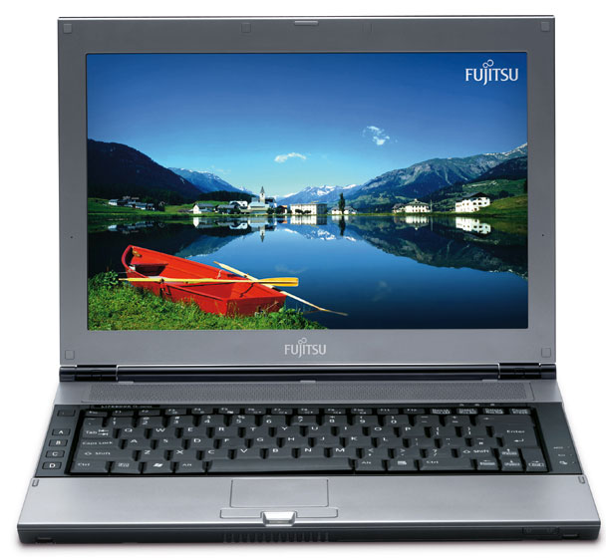
-put-
reputation
computer
dispute
Disreputable
Input
output
think !!!!!!!

Slide 22
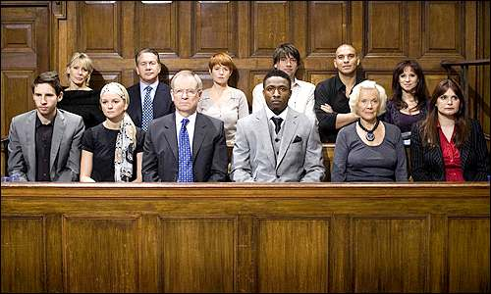
ver-
verdict (to ‘say’ the ‘truth’)
verify
veracity
veritable
true !!!!!!!

Slide 23
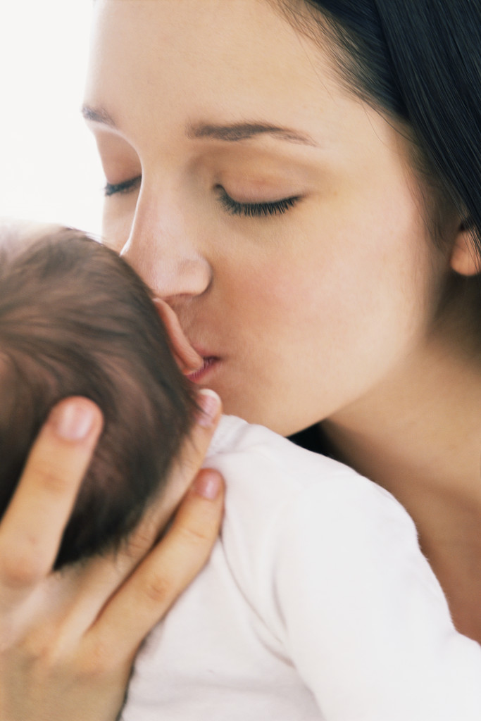
matri-
matrimony
matriarch
matron (as in the matron of honor at a wedding)
mother!!!!!!!

Slide 24
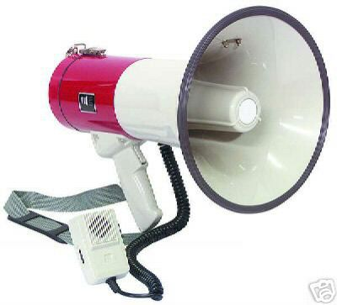
mega-
megaphone
megahertz
megaton
megalomania
mega-size
large !!!!!!!

Slide 25
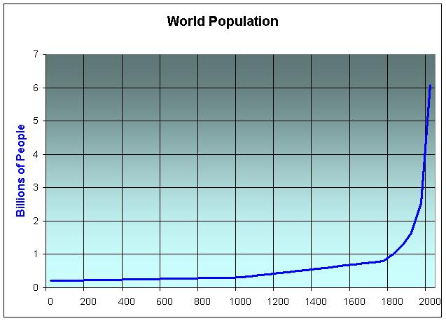
pop-
population
populate
popular
populist
people !!!!!!!

Slide 26
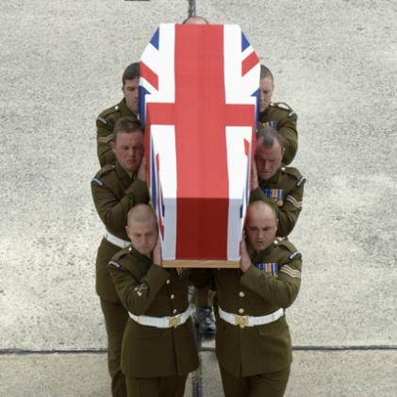
sangui-
sangria
sanguine
sanguinary (as in describing a war)
blood !!!!!!!

