Slide 1
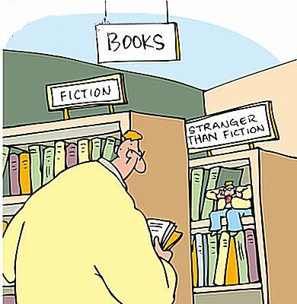
Nonfiction Unit
Informational Text, Memoirs, and Persuasive Writing
Up to half or more of your EOC will be non-fiction or informational text.

Slide 2
Nonfiction characteristics
Nonfiction is based on some sort of fact: it can be verified as factual in some way. It is also known as informational text.
Nonfiction is based on fact, but it would be a mistake to assume that “fact” and “truth are the same thing. It is impossible to “tell the whole truth” about any experience. The very act of putting something into words changes it. The particular words we choose to tell something about an experience is influenced by our personality, beliefs, prejudices, and our experiences. In other words, who we are shapes how we write about factual information.

Slide 3
Objective vs. Subjective
A nonfiction writer can be objective or subjective.
Objective writing – Writing that reveals no personal emotions, opinions, or judgments; the writer is invisible. Such writing can be proven true.
- news reports, informational articles, encyclopedia articles and historical accounts
Subjective writing – Writing that does reveal his or her feelings, opinions, and even biases.
- personal essays (memoirs), autobiographies, persuasive essays, editorials

Slide 4
Connotation/Denotation
Connotation: the suggesting of a meaning by a word apart from the thing it explicitly names or describes
  Positive – patriotism, honesty, and truth
  Negative – terrorism, lazy, sneaky, and lies
  Neutral – clipboard, chair, sidewalk
Denotation: a direct, specific meaning or dictionary meaning
Writers use connotative meanings to convey a deeper meaning in the nonfiction selection. Using connotations, you can infer about a selection’s theme or deeper meaning.

Slide 5

Puppy
Connotation
  Sweet, Cuddly, Adorable
  Youthful, Innocent, Fragile
Denotation
  a dog less than one year old

Slide 6

Snake
Connotation
  Repulsive, scary, dangerous,
  Biblical Allusion – tricked Adam and Eve into eating the forbidden fruit. (Evil)
Denotation
  limbless, scaly, elongated reptile inhabiting tropical and temperate areas

Slide 7
A good writer of nonfiction has a purpose
  Four purposes of writing:
    Explain, inform
    Create a mood or stir an emotion
    Tell about a series of events
    Persuade the readers to believe something or do something.

Slide 8
Nonfiction Techniques:
To interest the reader, a nonfiction writer will use techniques we normally associate with fiction writing:
  Conflict
  Suspense
  Characters (real people, in this case)
  Dialogue (direct quotes from knowledgeable sources)
  Irony
  Humor
  Figures of speech (similes, metaphors, idioms, hyperbole, oxymorons…)

Slide 9

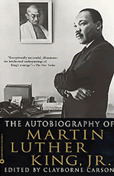
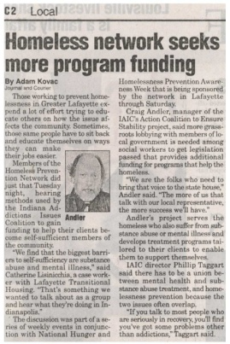




Types of Nonfiction
Nonfiction deals with real people, events, and places.
The most popular forms of nonfiction are biographies, autobiographies, and essays. Other examples include newspaper stories, magazine articles, historical writings, scientific reports and even personal diaries.

Slide 10

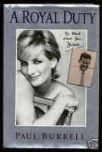
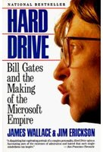
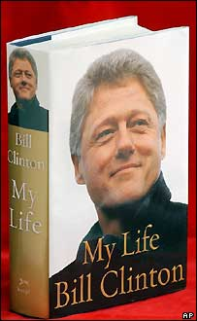

Autobiography/Biography
Autobiography – An account of a writer’s own life.
Biography – An account of a person’s life, written or told by another person (Usually written about historical or famous people).

Slide 11
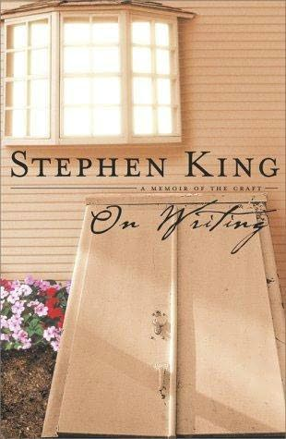
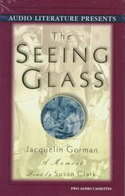



Memoir vs. Autobiography
A memoir is a piece of autobiographical writing, usually shorter in nature than a autobiography.
The memoir often tries to capture certain highlights or meaningful moments in one's past, often including a contemplation of the meaning of an event at the time of the writing of the memoir.
The memoir may be more emotional and concerned with capturing particular scenes, or a series of events, rather than documenting every fact of a person's life

Slide 12
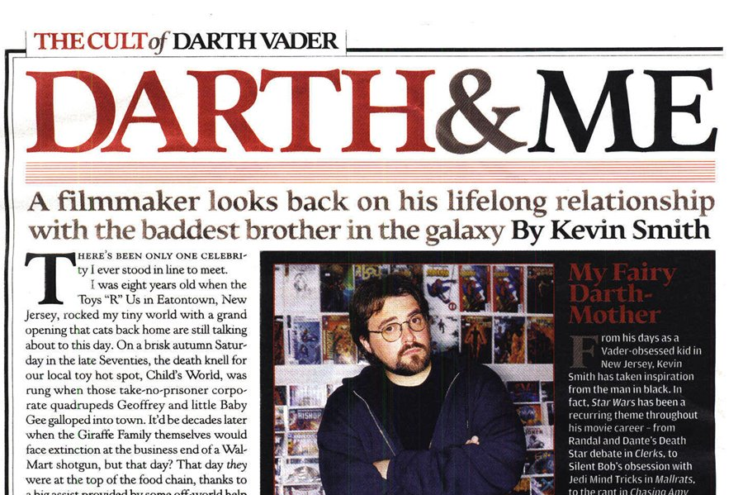
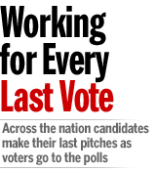
Essays
Essay – A short piece of nonfiction prose that examines a single subject from limited and usually personal point-of-view. Two types of essays are personal and formal.
  Personal Essay – is subjective and generally reveals a great deal about the writer’s personality and tastes. It is usually in conversational tone. Based on a writer's feelings and response to a personal experience.
  Formal Essay – is usually serious, objective, and impersonal in tone. Its purpose is to inform its readers about some topic of interest or to convince them to accept the writer’s views. Formal essays should be supported by facts and logic.

Slide 13
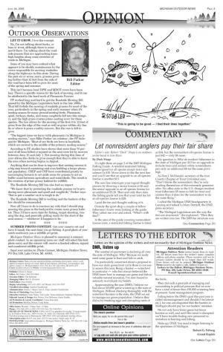
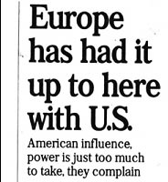
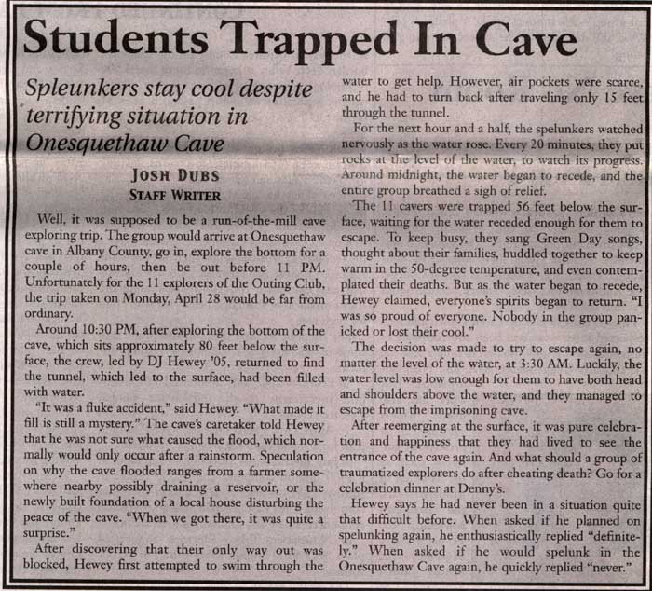
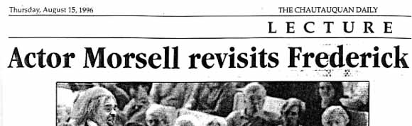
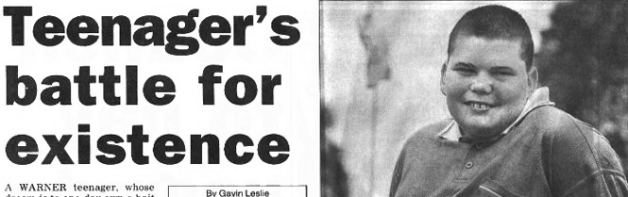
Three methods/purposes of non-fiction writing:
Descriptive – establishes a mood or stirs emotion.
Expository – informs, explains
Persuasive – convinces your audience to feel a certain way

Slide 14
Persuasion (writing with opinions)
Logical Appeals
Facts and statistics – give strong support to your reasons because nobody can argue with them.
Expert testimony – Statements made by an expert in the field are always convincing.
Faulty Reasoning or Fallacies
Hasty generalization – coming to a conclusions on the basis of insufficient evidence
Name calling – attacking the person who holds the view rather than the view itself.
Either/or – describing a situation as if there were only two choices when in fact there may be several
False cause and effect – asserting that because Event B followed Event A, A must have caused B

Slide 15
Persuasion
Emotional Appeals
Loaded Words - heavy with emotional connotations
Glittering generalities – a type of loaded words. They are so strong with positive that they “glitter” and make you feel good
Bandwagon appeal – this is the “Don’t miss out” or “Don’t be the last person to have one” appeal often used by advertisers.
Testimonials – when a basketball star endorses a candidate for the senate or brand of cereal

Slide 16
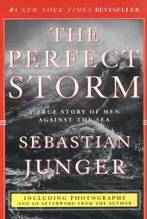



Nonfiction Narratives
We usually associate narratives with fiction, but nonfiction writers often tell true stories to make a point.
Nonfiction narratives are used in news reports, biographies, and histories.

Slide 17
Fact vs. Opinion
Fact - something true or accurate and having real-life existence. It can be proven.
Opinion – a belief held without evidence or proof.

Slide 18
Rhetorical Devices
Oxymoron
is a paradox reduced to two words, usually in an adjective-noun ("eloquent silence") or adverb-adjective (“delicately strong") relationship, and is used for effect, complexity, emphasis, or wit:
Ex: The coach’s solution was ridiculously brilliant. Love is bitter-sweet.
Rhetorical Question
is not answered by the writer, because its answer is obvious or obviously desired, and usually just a yes or no. It is used for effect, emphasis, or provocation, or for drawing a conclusionary statement from the facts at hand.
Ex: But how can we expect to enjoy the scenery when the scenery consists entirely of garish billboards?

Slide 19
Rhetorical Devices con.
Hyperbole
the counterpart of understatement, deliberately exaggerates conditions for emphasis or effect.
Ex: There are a thousand reasons why more research is needed on solar energy.
Understatement
…deliberately expresses an idea as less important than it actually is, either for ironic emphasis or for politeness and tact.
Ex: The 1906 San Francisco earthquake interrupted business somewhat in the downtown area.

Slide 20
Persuasion
Logical Appeals (mentioned on slide 14)
Facts and statistics – give strong support to your reasons because nobody can argue with them.
Expert testimony – Statements made by an expert in the field are always convincing.
Faulty Reasoning or Fallacies (from sl. 14)
Hasty generalization – coming to a conclusions on the basis of insufficient evidence
Name calling – attacking the person who holds the view rather than the view itself.

Slide 21
Making Inferences about Tone
When you read, you can’t hear the tone of the speaker’s or the narrator’s voice. Writers have to rely on word choice and details to communicate their tone, or attitude about their subjects. Readers must then piece together these clues to infer, or make an intelligent guess about, the writer’s feelings. A piece will have an overall tone, but also the tone may vary within the selection.

Slide 22
What you can expect for non fiction questions on the eoc…
Which provides an objective summary of the selection?
Based on the information in the selection, how did the use of [sarcasm- or any other device] impact the fourth passage?
In sentence one from paragraph three, what does the phrase “…” tell the reader?
What is the author’s organizational pattern for the selection?
What is the effect of the figurative language in section nine?

Slide 23
What you can expect for non fiction questions on the eoc…
What is the central idea of the selection?
What is the effect of the repetition of ___?
In sentence __, which sentence develops the author’s claim that (his claim from the text)?
Which quote from the selection supports the narrator’s assertion that (impression that) ___ ?
Which quote from the text illustrates how the narrator’s tone changes from __ to __?

Slide 24
What you can expect for non fiction questions on the eoc…
Which quote suggests the message that the narrator intended to deliver in writing about (topic)?
How does the author use language to advance his point of view?
How is the author’s organization of the text essential to the message he wants to convey?
Based on the context of the selection, what does the phrase __ mean?

Slide 25
What you can expect for non fiction questions on the eoc…
In the last sentence of section six, what does the word __ mean?
What can be inferred from sentence two from seventh section?

